Slide 1
GROUP PROJECT Emerging Technologies(COMP308)
By: Brinderjit Singh(300918321)
Daksh Kapur(300910369)
Piyush Sharma(300871240)
Anisha Velani(300917513)

Slide 2
What is E-health?
E-health is a new term used to describe the combined use of electronic communication and information technology in the health sector.
Also eHealth refers to various information and services that is either shared or modified through technology such as the internet.
The health care in developed countries at the start of the 25 century concerns consumerism and the empowerment of the patient.
E-health in general and the internet in particular have been seen as playing a vital role in facilitating this.
Health information on the interest now allows consumers to make informed choices about their health and to access the esoteric knowledge previously only available to health professionals.

Slide 3
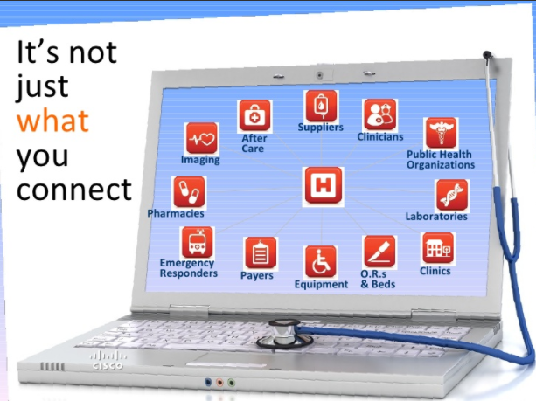
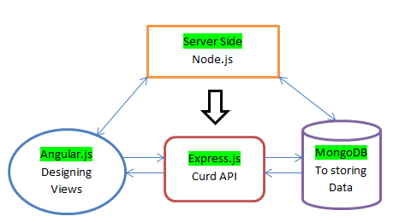
Application Architecture

Slide 4
Functionalities
User Registration
For Nurse:
-Enter vital signs
-Collect information of previous clinic visit
-Daily Motivational Tips to users
For Patient:
-Create and sends emergency alert
-Able to check common signs and symptoms
-Allow user to enter daily information system

Slide 5

Screenshots

Slide 6
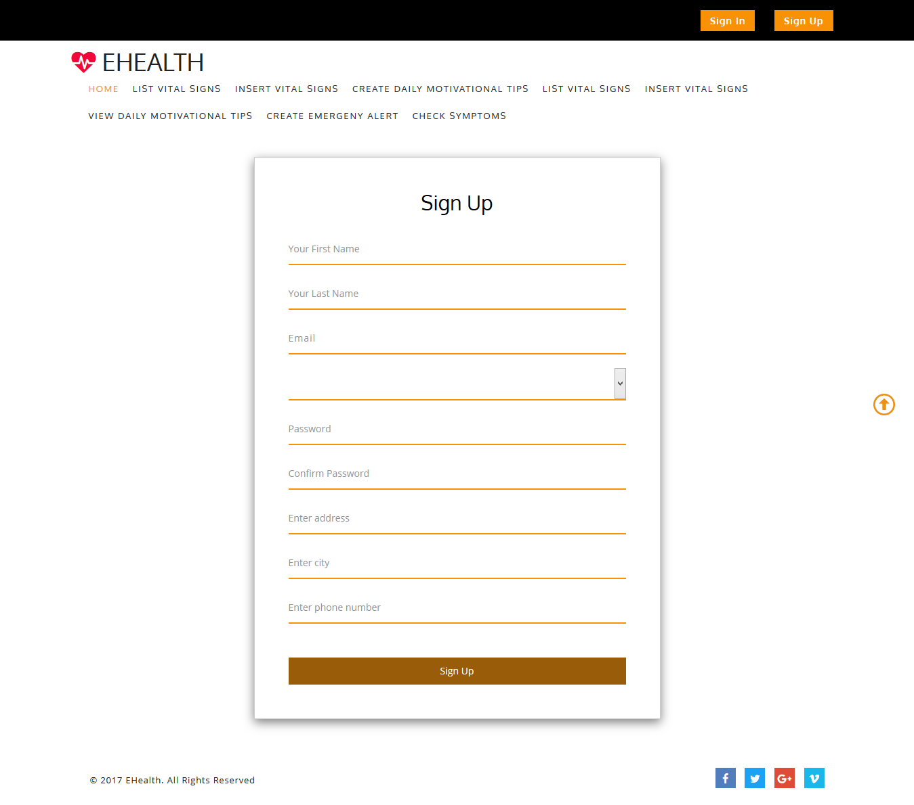

Slide 7
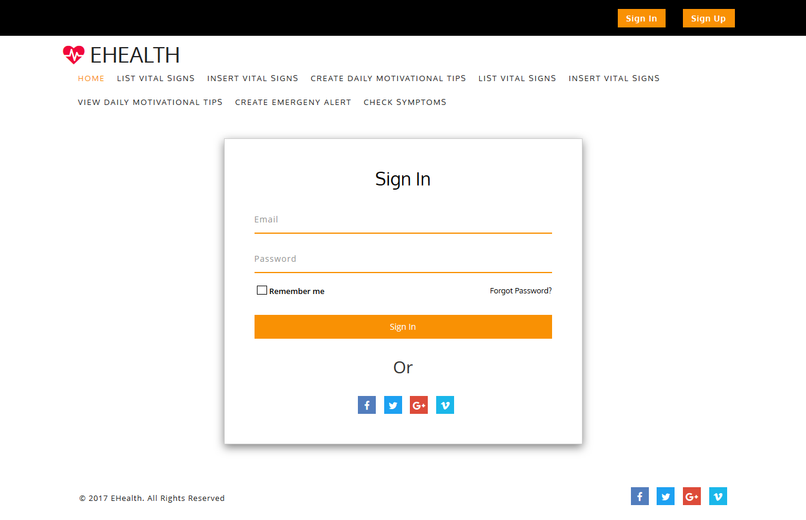

Slide 8
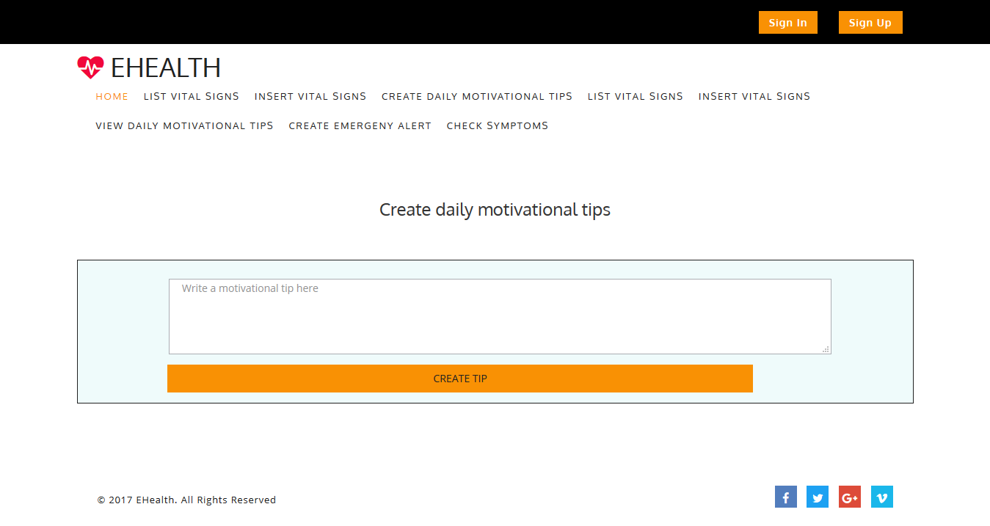

Slide 9
Thanks!
Any Questions?

